Slide 1
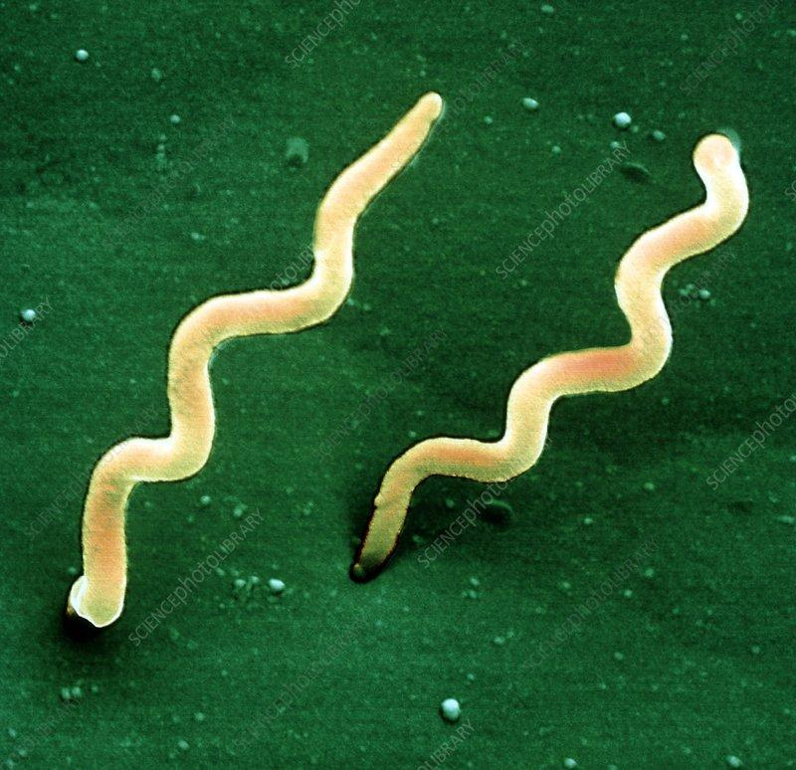
How does Borrelia Burgdorferi survive in its different hosts during its life cycle ?
By Emma Boehly, Constance de Trogoff, Virginie Garnier, Nicolas Lonchampt and Olivia Ruggaber

Slide 2
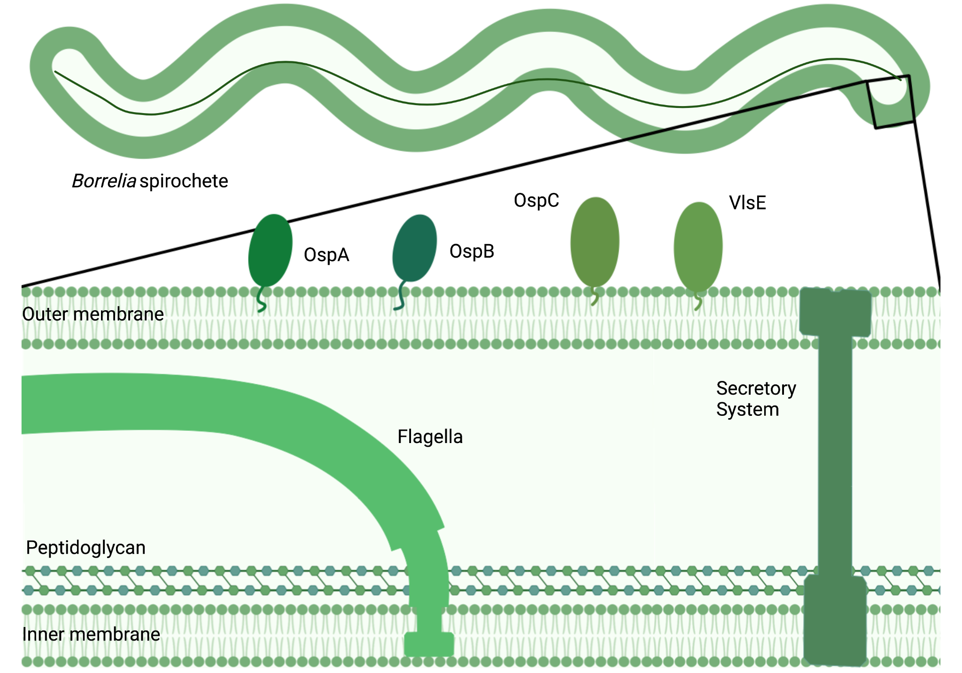
Borrelia Burgdorferi: Introduction and structure
Responsible for Lyme disease, using Black legged tick as its vector, mainly located in the Northern hemisphere
Of the Spirochaetaceae family, measuring 10-25 um long
Capsule : (Gram negative)
inner membrane
peptidoglycan
outer membrane
Lacks LPS in its outer membrane
→ immunoreactive glycolipids instead
Flagella : periplasmic space
→structure and motility
Linear chromosome

Slide 3
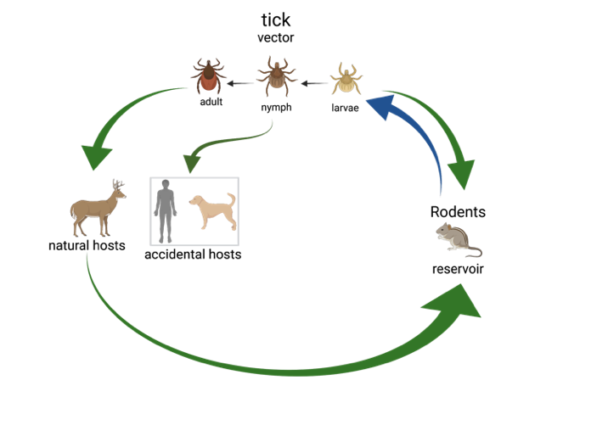
How does Borrelia Burgdorferi travel from one organism to another to maintain persistent infection?
On accidental hosts (Spring-Summer)
Nymph ticks attach
Infect
Humans develop inflammatory reaction
The disease vector
carry the bacteria from reservoirs to hosts
Reservoirs
Larvae that hatched, feed and get infected
Infected larvae infect other rodents
On natural hosts (Fall)
Adult female ticks attach
Infect
Mate and lay eggs
What are reservoir hosts and why are they essential?
they maintain persistent infection among all populations, by allowing reinitiation of the cycle
Borrelia Burgdorferi must resist long enough in reservoirs, so that uninfected larvae can get infected via blood meal
Reservoirs (white-footed mouse) are immunocompetent and do not develop an inflammatory response upon infection
« Existence of a reservoir is confirmed when infection within the target population cannot be sustained after all transmission between target and non-target populations has been eliminated. »
Quote from: Identifying Reservoirs of Infection: A Conceptual and Practical Challenge. Emerg. Infect. Dis. 8, 1468–1473 (2002).

Slide 4
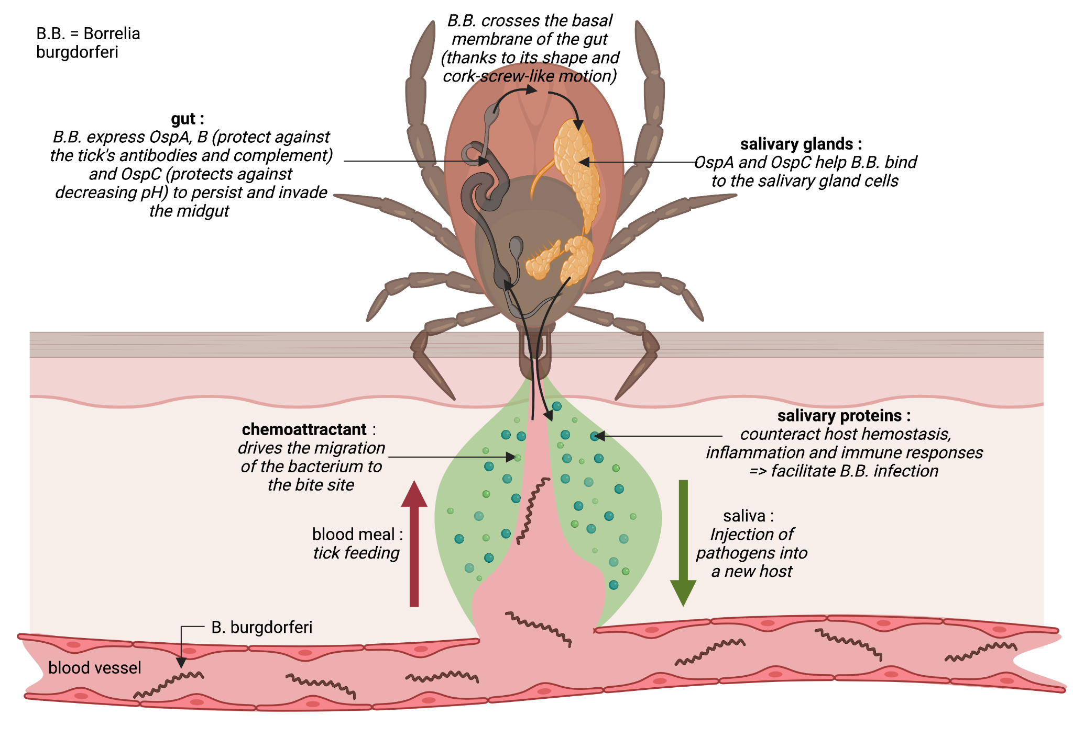
Life cycle and persistence in tick

Slide 5
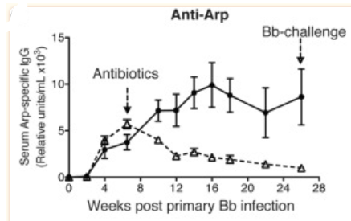
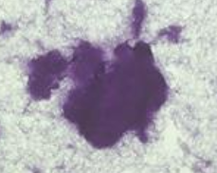

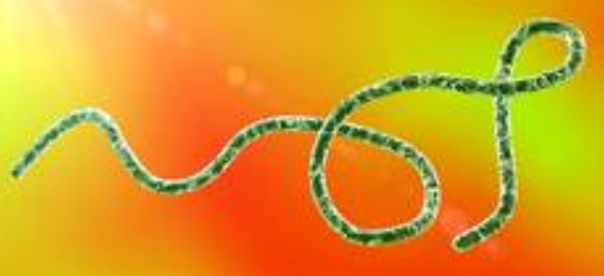
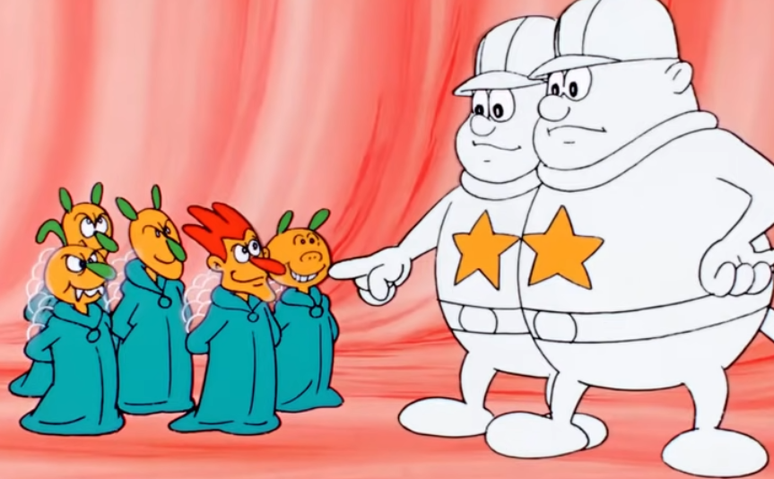

How does borrelia burgdorferi survive in its mammalian host ?
It migrates to the lymph nodes and prevents the formation of long-lived IgG by interfering with germinal center formation.
It is able to form protective biofilms, physically hiding from antibiotics and humoral immunity.
Antigenic variation of its VlsE lipoprotein protects the bacterium against specific antibodies
The bacterium binds various host’s and tick’s proteins to go unnoticed by the immune system

Slide 6
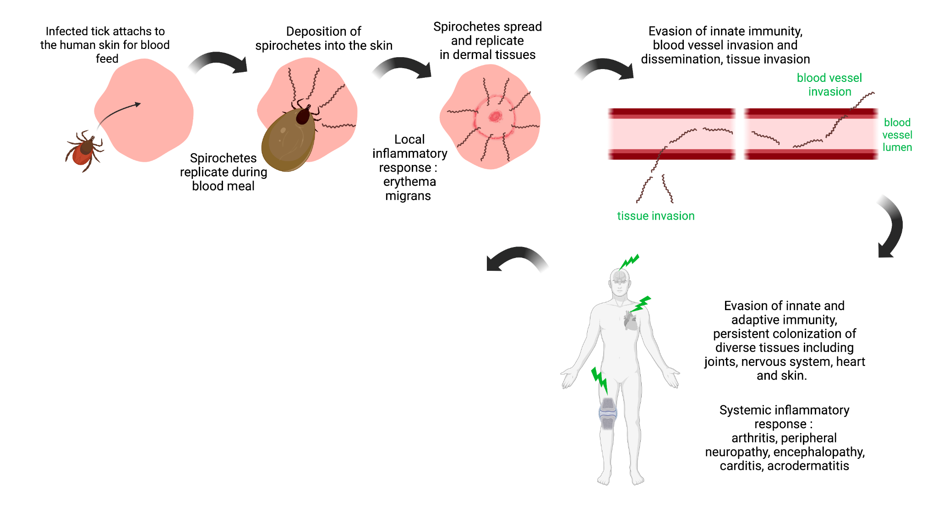
Humans inflammatory response and Treatment Research
Treatment Research is crucial
Vaccines :
- Problem : gene sequence variations coding for surface proteins within species
- Potential solutions :
design multivalent recombinant protein vaccine
design vaccine to induce an inflammatory response to tick’s salivary proteins
Antibiotics :
- When are they efficient ? mainly during the early dissemination phase
- Why do they lose their effectiveness after this phase ?
Because they formed biofilms which confer resistance to antibiotic penetration

Slide 7
References
1.
Timmaraju, V. A. et al. Biofilm formation by Borrelia burgdorferi sensu lato. FEMS Microbiol Lett 362, fnv120 (2015).
2.
Tilly, K., Rosa, P. A. & Stewart, P. E. Biology of Infection with Borrelia burgdorferi. Infect Dis Clin North Am 22, 217–234 (2008).
3.
Tracy, K. E. & Baumgarth, N. Borrelia burgdorferi Manipulates Innate and Adaptive Immunity to Establish Persistence in Rodent Reservoir Hosts. Front Immunol 8, 116 (2017).
4.
Lawrenz, M. B. et al. Human Antibody Responses to VlsE Antigenic Variation Protein of Borrelia burgdorferi. J Clin Microbiol 37, 3997–4004 (1999).
5.
Kurokawa, C. et al. Interactions between Borrelia burgdorferi and ticks. Nat Rev Microbiol 18, 587–600 (2020).
6.
Radolf, J. D., Strle, K., Lemieux, J. E. & Strle, F. Lyme Disease in Humans. Curr Issues Mol Biol 42, 333–384 (2021).
7.
Gomes-Solecki, M. et al. Protective Immunity and New Vaccines for Lyme Disease. Clin Infect Dis 70, 1768–1773 (2020)

